Slide 1
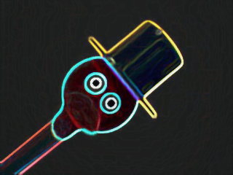

Slide 2
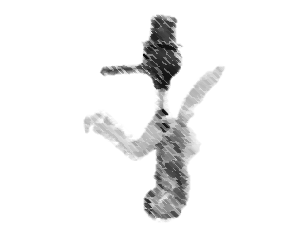
生科系
朱彥如
周霈

Slide 3
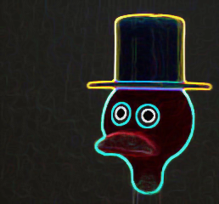
WOW!!

Slide 4
Drinkin’ Bird

Slide 5
時間暫停

Slide 6
示範

Slide 7
時間開始

Slide 8
About A Drinkin’ Bird

Slide 9
HOW DOES IT WORK?

Slide 10
ANSWER

Slide 11
Saturated Vapor Pressure

Slide 12
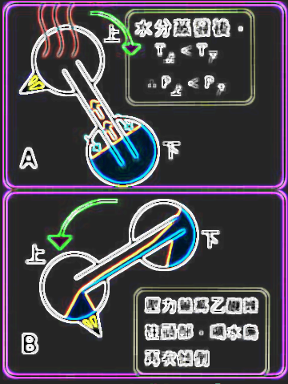

Slide 13
Equ. Of T & P

Slide 14
ln(P1/P2)=(L/R)*(1/T1-1/T2)

Slide 15
About PV=NRT

Slide 16
COMMON MYTH

Slide 17
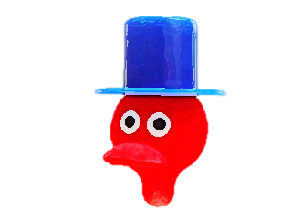
Isobaric Process

Slide 18
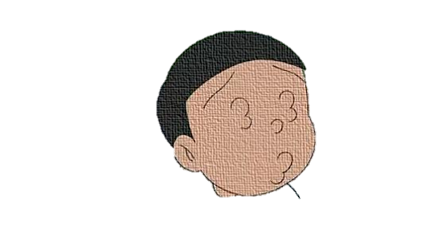
違う

Slide 19
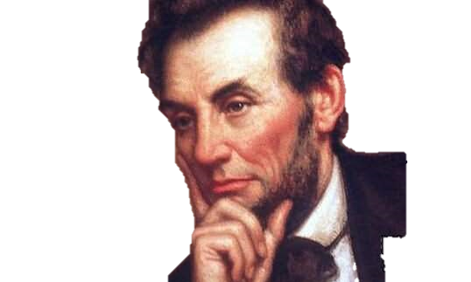
WHY?

Slide 20

BECAUSE

Slide 21
假設溫差 ∆T = 10K

Slide 22
V上 (273+30) V下 (273+20)
=

Slide 23
ANS:1.034 ∆V = 3.4%

Slide 24
petit 小

Slide 25
Saturated Vapor Pressure 飽和蒸汽壓

Slide 26
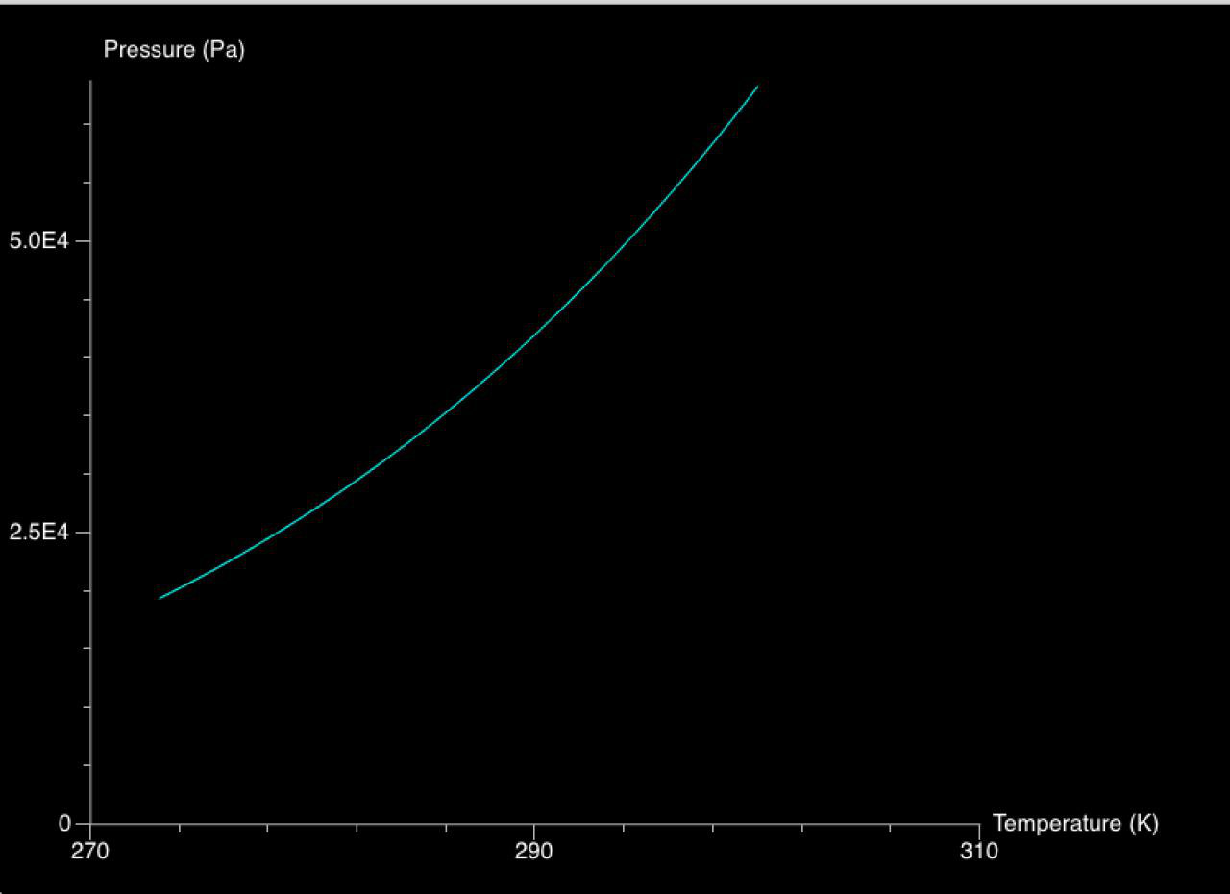

Slide 27
∆P/P =3.0e4/ 3.5e4

Slide 28
ANS:0.857 ∆V = 85.7%

Slide 30
modeling 模擬

Slide 31
code 程式碼

Slide 32
structure 架構

Slide 33
UML_DIAGAM
),size=10,material=materials.emissive,color=color.red)
self.eye2=points(frame=self.drinking_bird,pos=self.Upper_ball.ball.pos+vector(self.upper_ball_r-1.0E-3,2.0E-3,2.0E-3),size=10,material=materials.emissive,color=color.red)
self.support=cylinder(pos=(0,0,self.tube_r),axis=(0,-5E-2,0),radius=(0.1E-2),color=color.red,opacity=0.7)
self.drinking_bird.pos=(0,0,0)
self.locate=arrow(pos=(0,0,0),axis=(0,0.25E-2,0),color=color.red)
self.main(self.dt)
def main(self,dt):
self.P_b=self.Clapeyron_equation(self.T_room)
while(True):
rate(10000)
self.t+=dt
self.T_h=self.delta_T(self.t)
self.P_h=self.Clapeyron_equation(self.T_h)
#delta pressure
self.delta_P=self.P_b-self.P_h
self.BR_aka_BuzzRhyme(self.delta_P,self.Tube)
#time lapsed
self.time_lapsed(dt)
def rotation(self,vector,angle):
new_vector=rotate(vector,abs(angle),angle)
return new_vector
def Inertia(self):
#Total
total_I=self.Tube.I+self.Lower_ball.I+self.Upper_ball.I
return total_I
def time_lapsed(self,dt):
#global self.J,self.L,self.phi,self.omega
self.I=self.Inertia()
#Torque
#Torque from bird
###
J_bird=(self.Lower_ball.m_all)*cross(vector(0,-self.g,0),self.rotation((self.Tube.tube.axis)/2,self.phi))-self.Upper_ball.m_all*cross(vector(0,
-self.g,0),self.rotation((self.Tube.tube.axis)/2,self.phi))-(self.beak.m+self.sponge_m)*cross((0,-self.g,0),(self.rotation(self.beak.pos,self.phi)-self.drinking_bird.pos))
#Torque from liquid
liquid_com=self.rotation((self.Tube.liquid.axis-self.Tube.liquid.pos)/2,self.phi)
J_liq=self.Tube.h_m*cross(vector(0,-self.g,0),(self.drinking_bird.pos-liquid_com))
#Torque Total
self.J=J_liq+J_bird
#omega
self.omega+=self.J/self.I*dt
#damping
self.omega-=self.omega*self.b
self.phi+=self.omega*dt
self.drinking_bird.rotate(angle=abs(self.omega)*dt,axis=self.omega)
def delta_T(self,t):
head_T = -0.01*(t%20.0) + self.T_room
return head_T
#For Dichloromethane
def Clapeyron_equation(self,T):
P_sat=exp((log(760/101.325)-10.08632*log(T)-6030.610/(T)+80.87786+9.812512E-6*(T)**2))*1.0336E5/760.0
return P_sat
def BR_aka_BuzzRhyme(self,dP,Tube):
h=dP/(self.liquid_d*self.g)
self.Tube.get(h)
self.Lower_ball.get(self.Tube.h_m)
class bird_ball:
def __init__(self,frame,pos,radius,iradius,liq_v,liq_d,density):
self.ball=sphere(frame=frame,pos=pos,radius=radius,color=color.cyan,opacity=0.7)
self.iradius=iradius

Slide 34
執行 Execution

Slide 35
展示 Demonstration

Slide 36
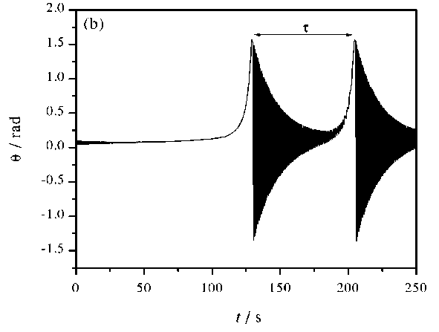
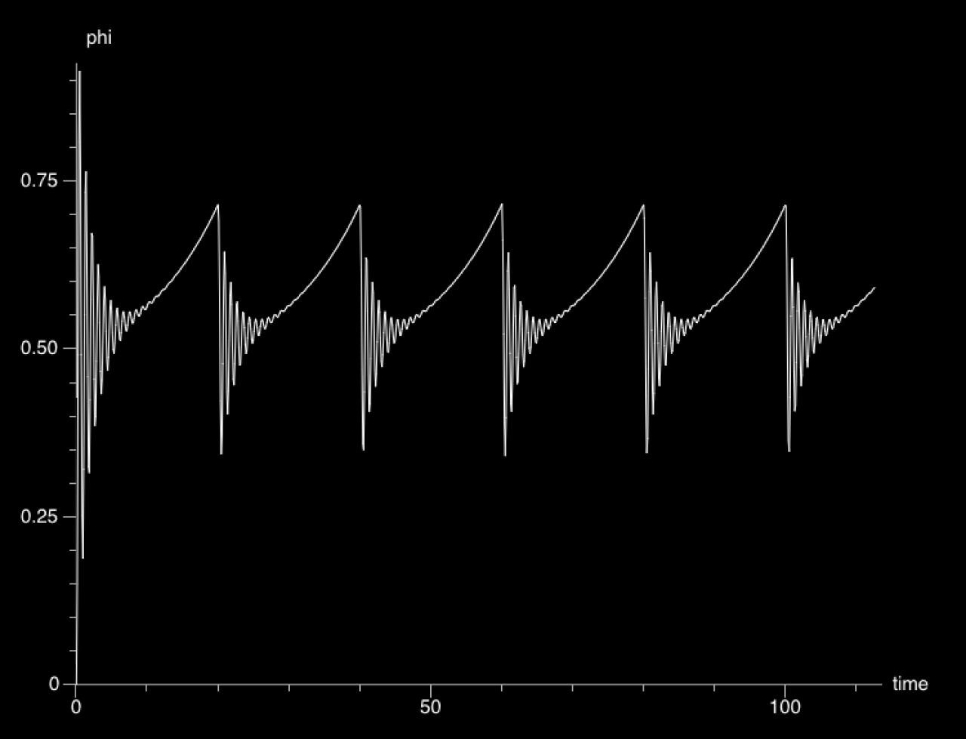

Slide 37
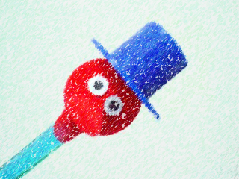

Slide 38
謝謝

Slide 39
Grazie!

Slide 40
reference
Experiments with the drinking bird,
J. Guemez , R. Valienteb, C. Fiolhais and M. Fiolhais
The thermodynamics of the drinking bird toy,
Lily M Ng and Yvonne S Ng
http://www.mecaflux.com/en/Saturation%20vapor%20pressure.htm
演示實例之理解與誤解:以「喝水鳥」與「愛情溫度計」 為例，
張慧貞
https://zh.wikipedia.org/wiki/%E5%85%8B%E5%8A%B3%E4%BF%AE%E6%96%AF%EF%BC%8D%E5%85%8B%E6%8B%89%E4%BD%A9%E9%BE%99%E6%96%B9%E7%A8%8B

